Slide 1
CSDA 1050 Capston Project Podcast

Slide 2
Objectives
To help Canadian podcast publishers and provide recommendations to understand different segments of podcast listeners.
To inform business opportunities in this growing media sector.
To identify growth areas compare with previous research.

Slide 3
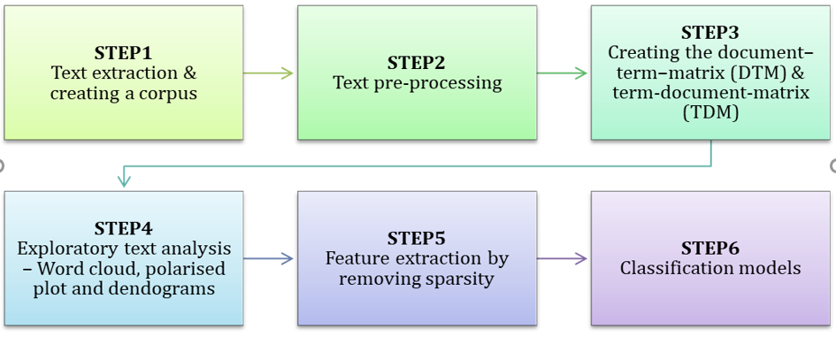
High level approach

Slide 4
STEP1 — Text extraction & creating a corpus
The column Review.Text contains the customer reviews received for various products. This is the focus for our analysis. We will now try to understand how to represent text as a data frame.
First, the review.text is converted into a collection of text documents or “Corpus”.
To convert the text into a corpus, we use the “tm” package in R.
In order to create a corpus using tm, we need to pass a “Source” object as a parameter to the VCorpus method.

Slide 5
STEP2 — Text Pre-processing
To ensure that the DTM and TDM are cleaned up and represent the core set of relevant words, a set of pre-processing activities need to be performed on the corpus. This is similar to the data clean-up done for structured data before data mining. The following are some of the common pre-processing steps:
Convert to lower case
Remove punctuation
Remove stopwords
Stemming a document
Frequently used words

Slide 6
STEP3 — Create the DTM & TDM from the corpus
The pre-processed and cleaned up corpus is converted into a matrix called the document term matrix.
A document-term matrix is a mathematical matrix that describes the frequency of terms that occur in a collection of documents. In a document-term matrix, rows correspond to documents in the collection and columns correspond to terms.
The term-document matrix is a transpose of the document-term matrix. It is generally used for language analysis. An easy way to start analyzing the information is to change the DTM/TDM into a simple matrix using as.matrix().

Slide 7
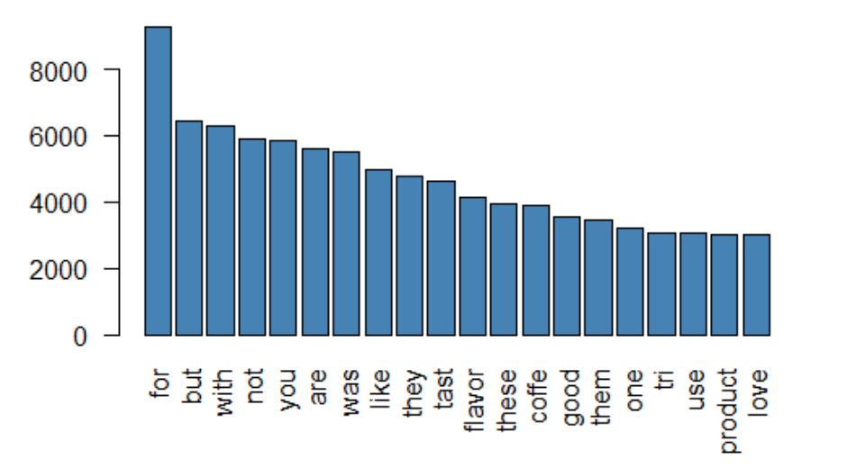
STEP4 — Exploratory text analysis

Slide 8
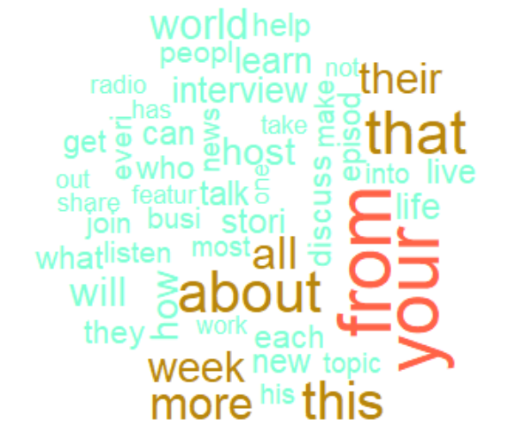
Word clouds
Word clouds:- Word cloud is a common way of visualizing a text corpus to understand the frequently used words. The word cloud varies the size of the words based on the frequency. The word cloud can receive a set of colors or a color palette as input to distinguish between the more and the lesser frequent words in the cloud.

Slide 9
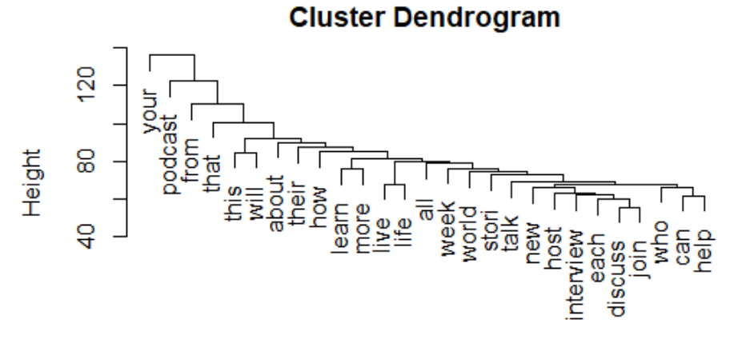
Simple word clustering: -
Simple word clustering: - Word clustering is used to identify word groups used together, based on frequency distance. This is a dimension reduction technique. It helps in grouping words into related clusters. Word clusters are visualized with dendrograms.

Slide 10
STEP5 — Feature extraction by removing sparsity
Concept of sparsity
Sparsity is related to the document frequency of a term. In DTM, since the terms form the columns, every document will have several columns each representing one term — a unigram, bi-gram, tri-gram, etc.
Feature extraction
The exploratory text analysis has given several insights based on the customer reviews. We will now use the same review text as predictor variable to predict whether the product will be recommended by the customer. In terms of classification algorithms used, there is not much of a difference between data and text input. We will try 3 of the most popular classification algorithms — CART, Random forest

Slide 11
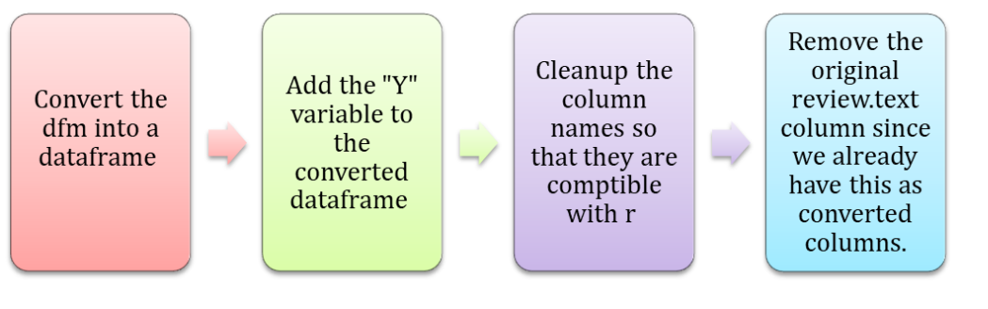
STEP6 — Building the Classification Models

Slide 12
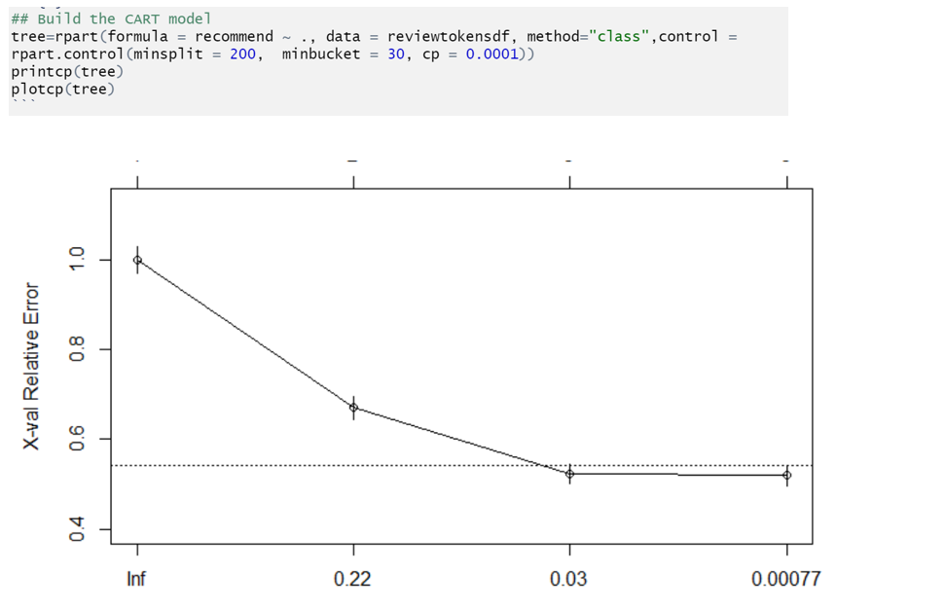
CART model

Slide 13
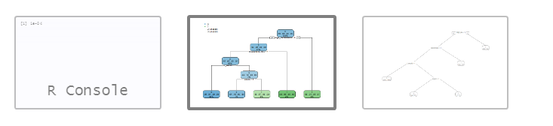
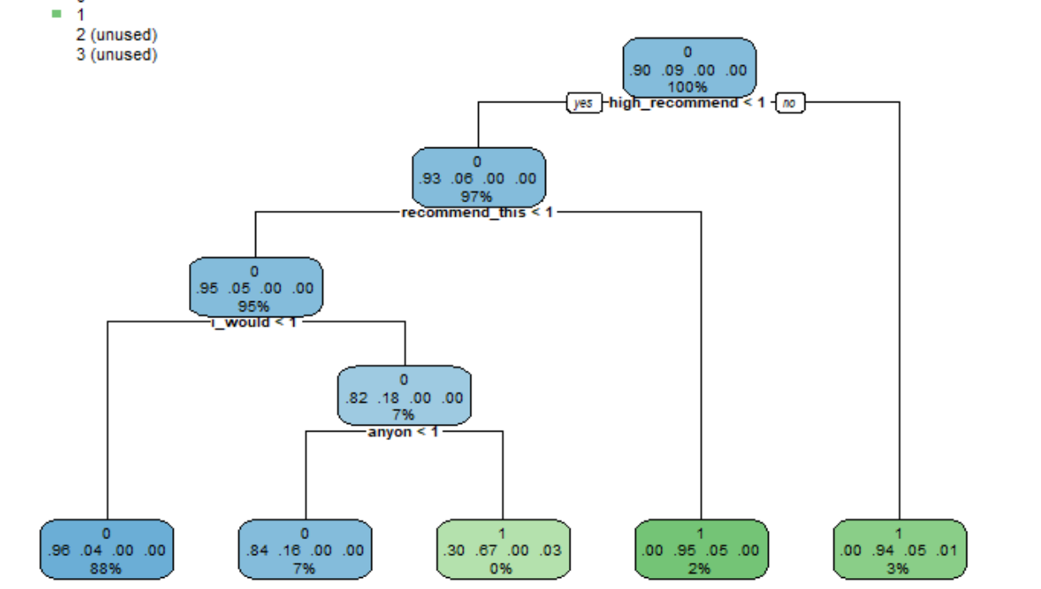
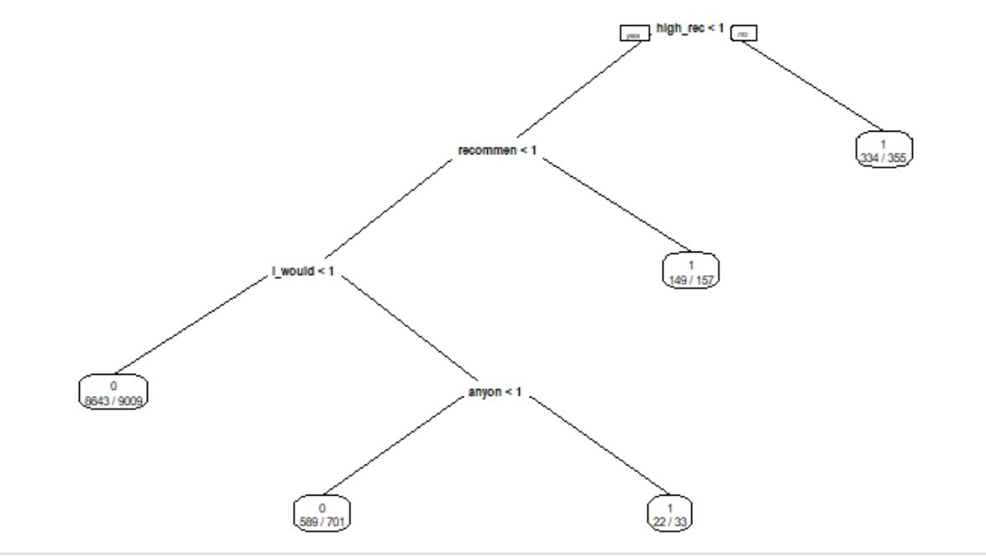
CART model

Slide 14
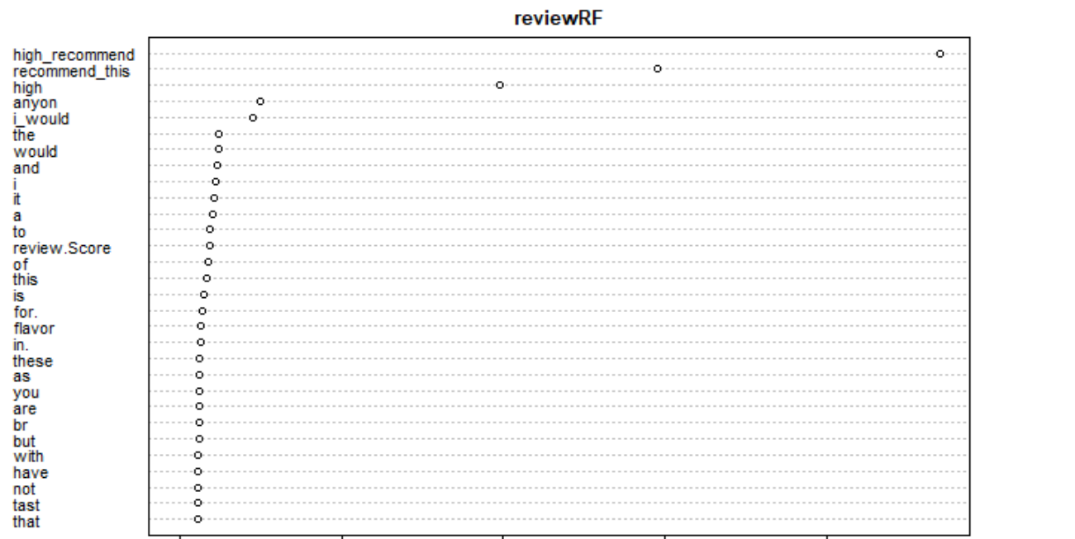
Random forest
The next classification algorithm we will use is the Random forest. We will examine the varimp plot of the random forest model to understand which words affect the classification the most.

Slide 15
Conclusion
In sync with the CART model, the varimp plot of the Random forest model also , words like “High Rec”, “recommend”, “I would”, etc are used by happy customers — i.e., customers do recommend the product. The tree can be interpreted further to understand the word patterns used by customers who recommend the product vs those who don’t.

